Slide 1


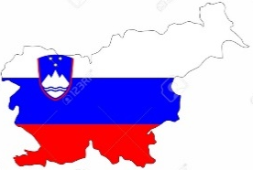
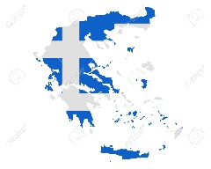



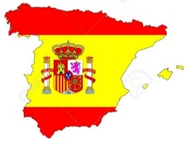

2.016 – 2.018
HOME ALONE

Slide 2
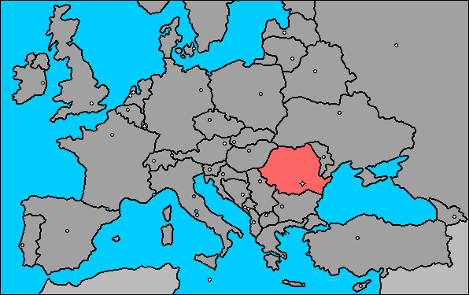
7
Latvia
6
Lithuania
1
Poland
5
Romania
4
Slovenia
3
Spanish
2
Greece
The smell is related to intuition: proximity and neighbourhood

Slide 3

POLAND

Slide 4
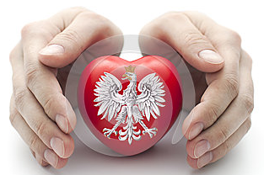
Througt
The
senses
THE SMELL

Slide 5
In the spanish lenguaje
The smell
is relatid to
The intuition, the knowledge.
¡¡¡¡ Let´s smell Poland !!!!

Slide 6
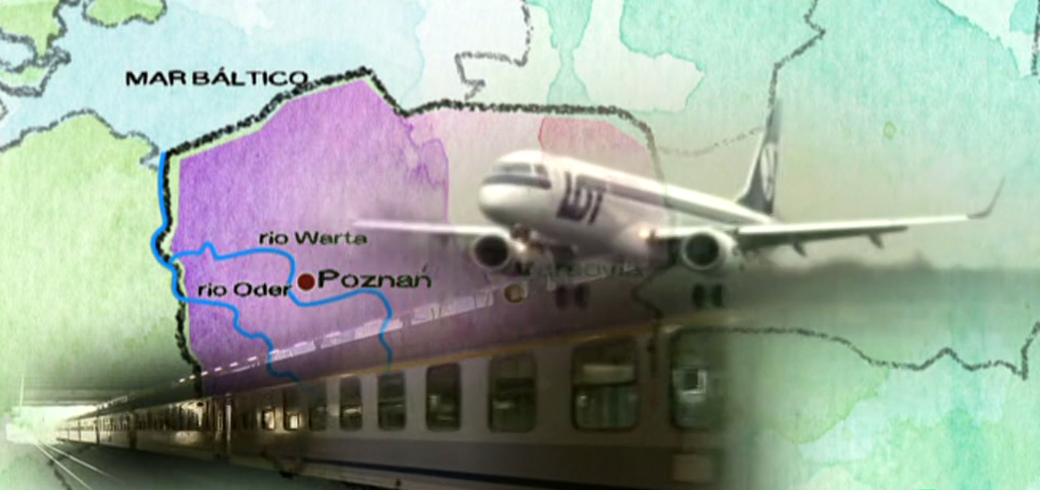
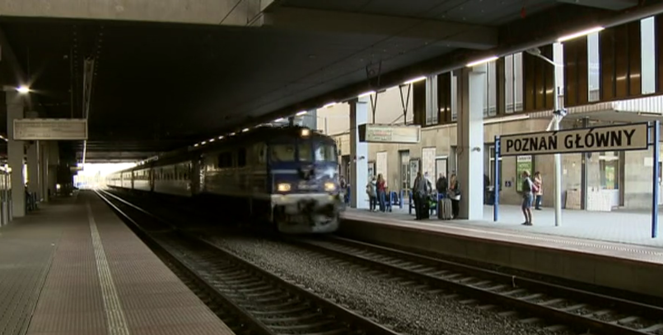

Slide 7
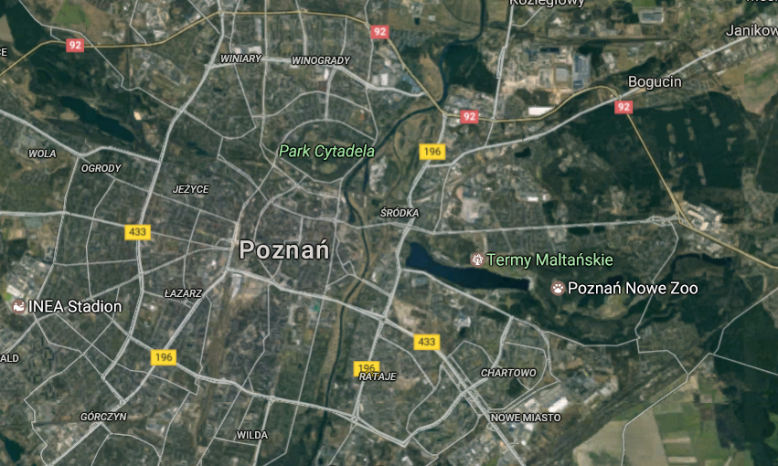
The smell is related to knowledge: the discover of unknowledge
HUMANITY MOTOR

Slide 8
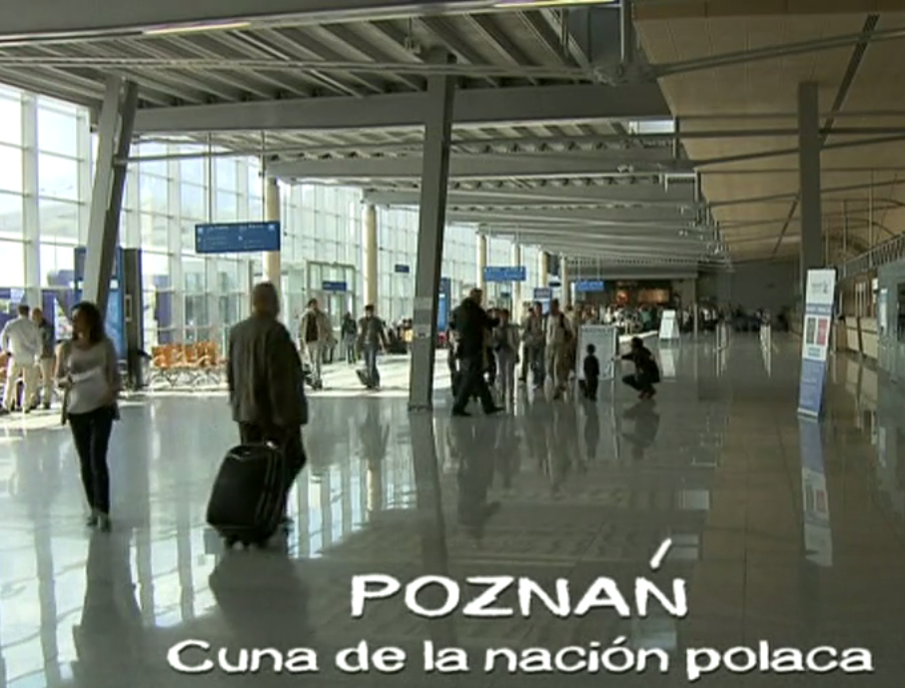
POZNÁN
CRADLE OF THE POLAND NATION

Slide 9
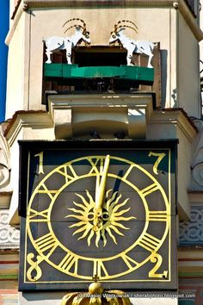
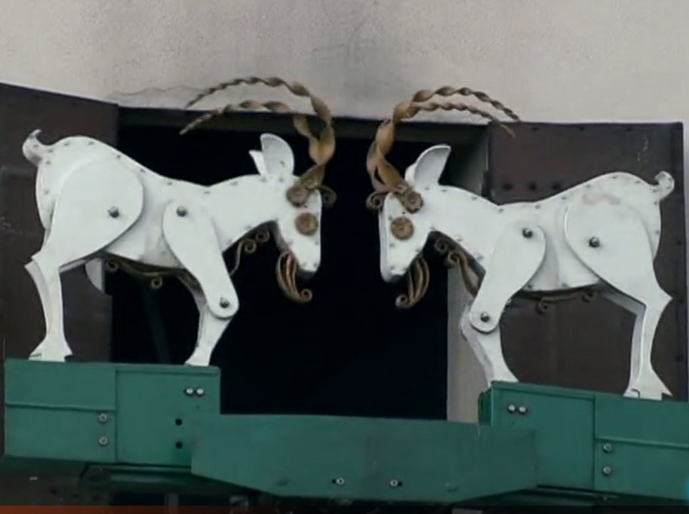
Identity
smell

Slide 10
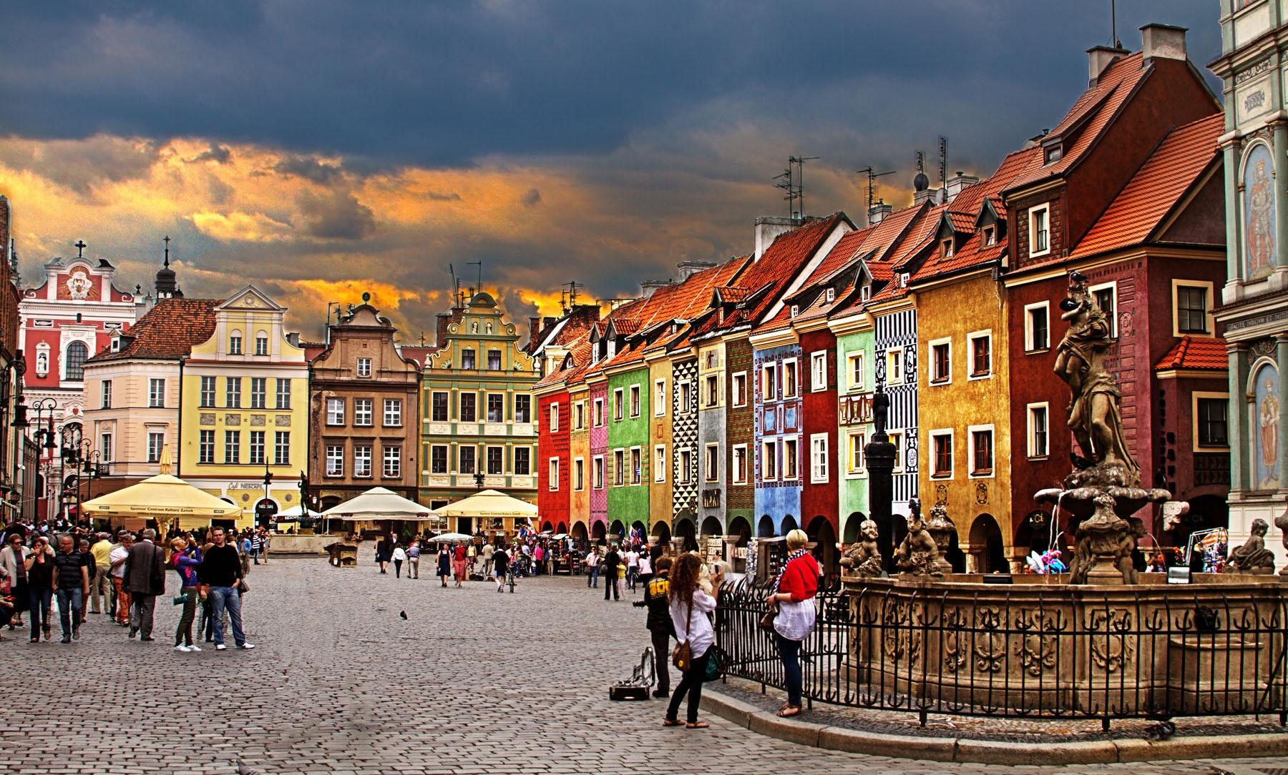
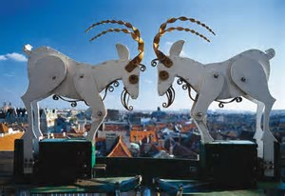
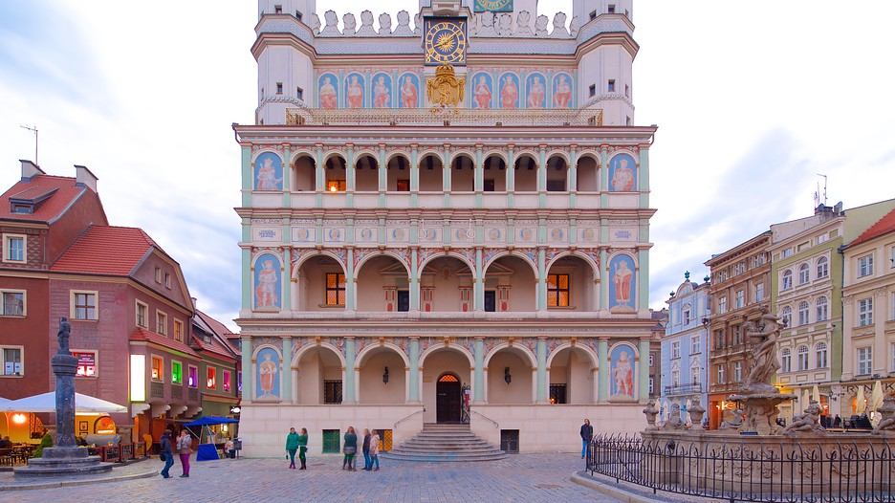
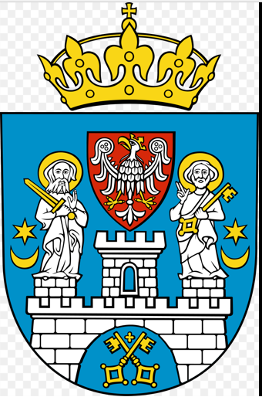
Identity
smell

Slide 11
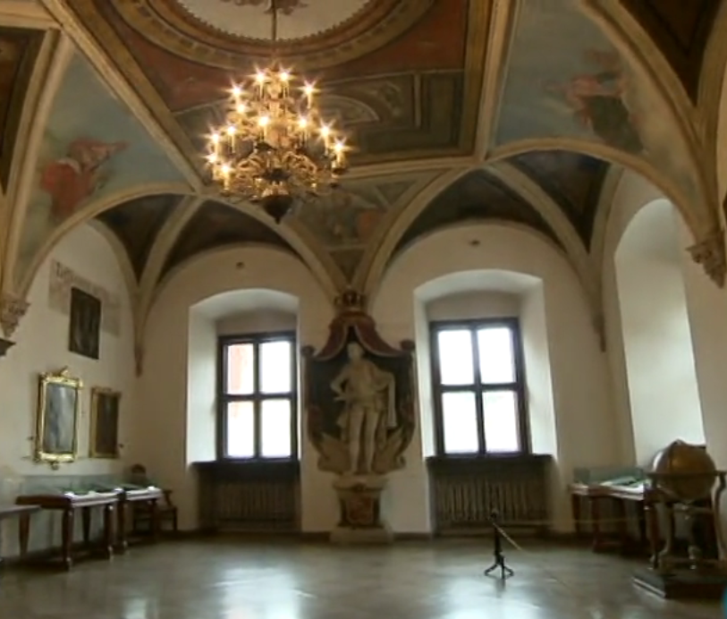
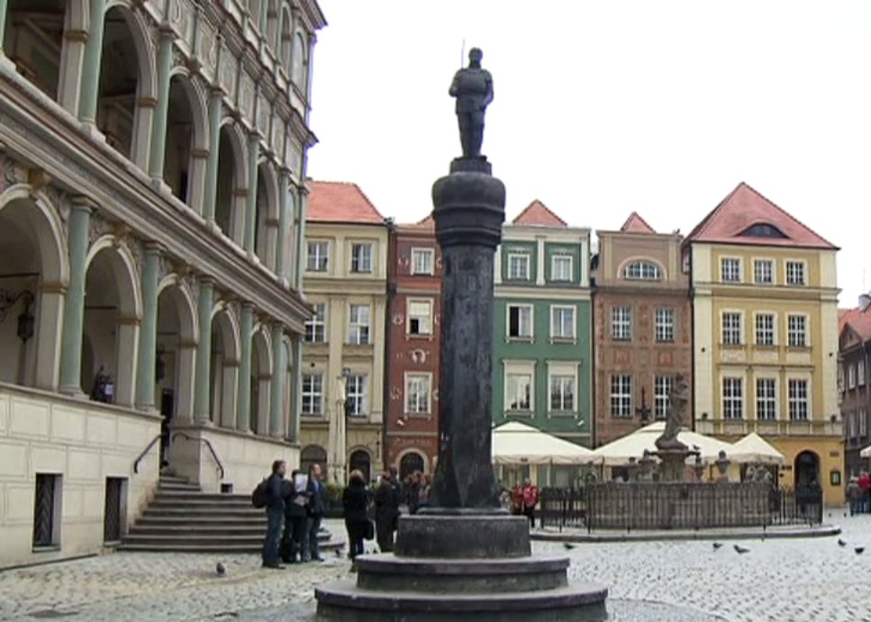
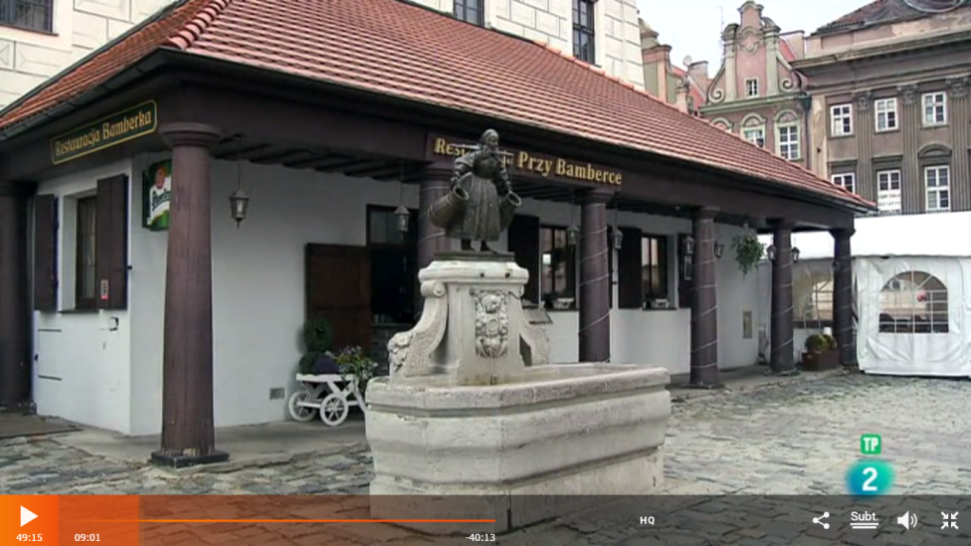
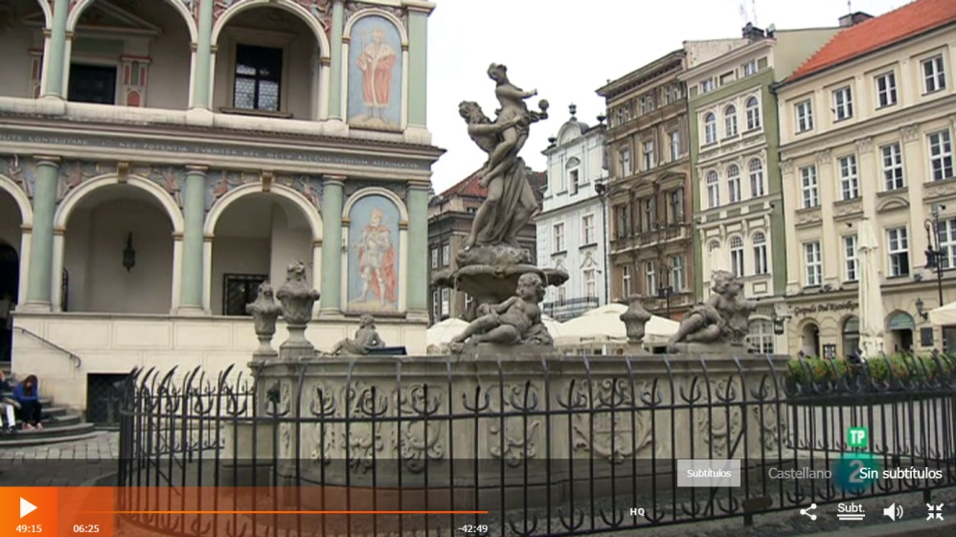
Identity
smell
THE PICOTA
TOWN HALL POZNAN
RAPTO DE PROSERPINA CATANIA FOUNTAIN
BAMBERKA STATUE

Slide 12
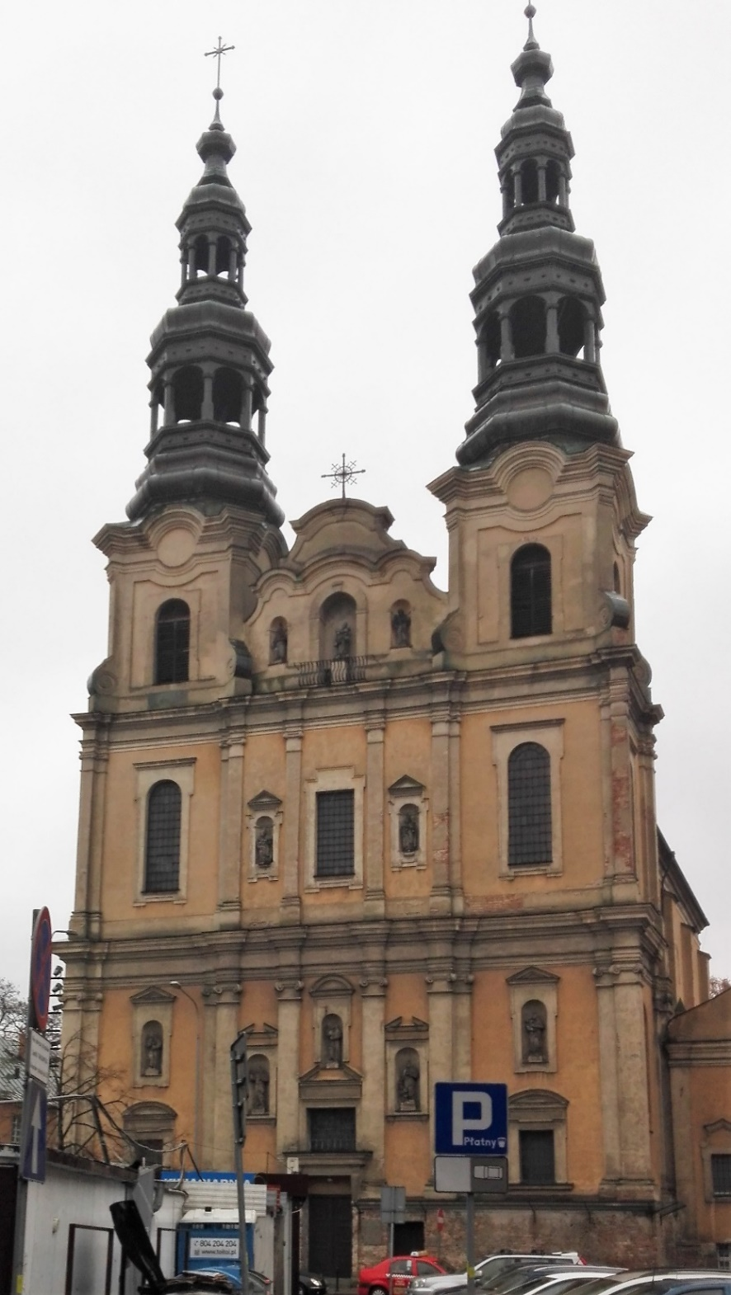
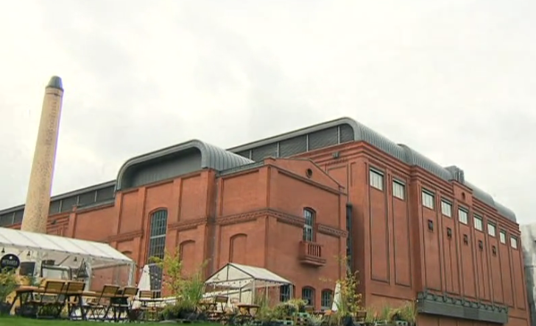
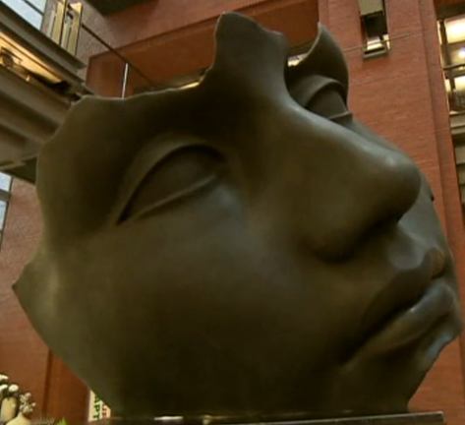
Identity
smell

Slide 13
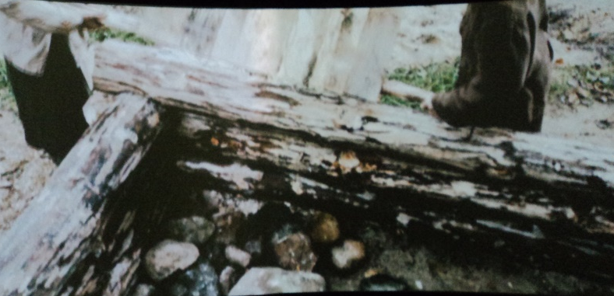
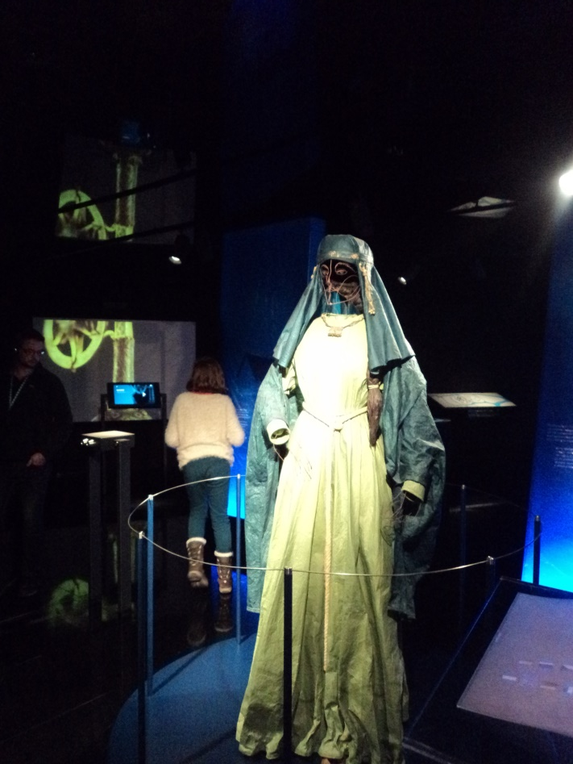
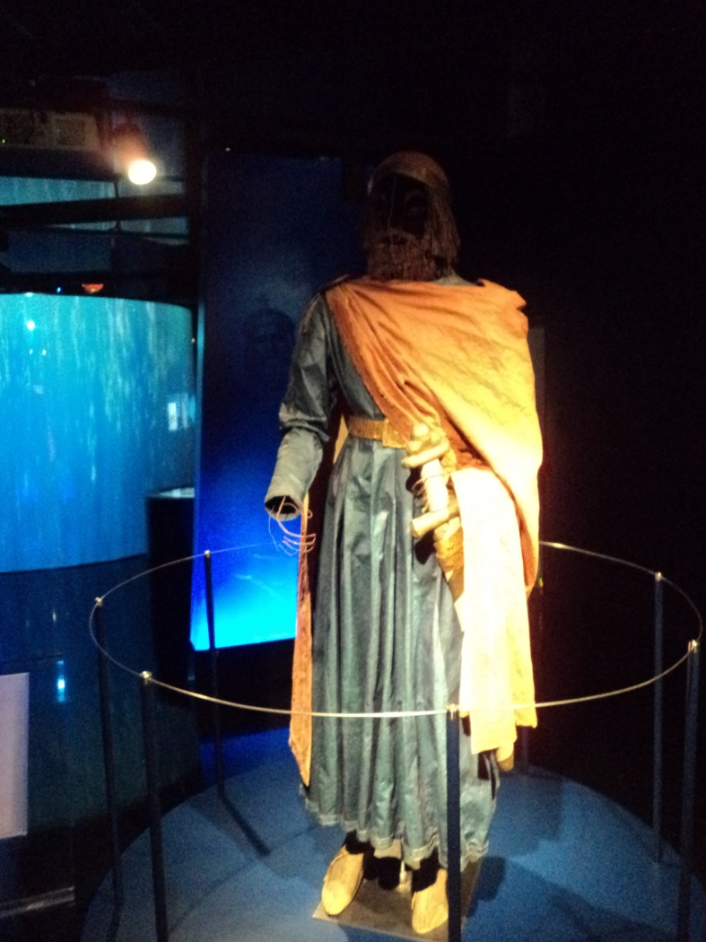
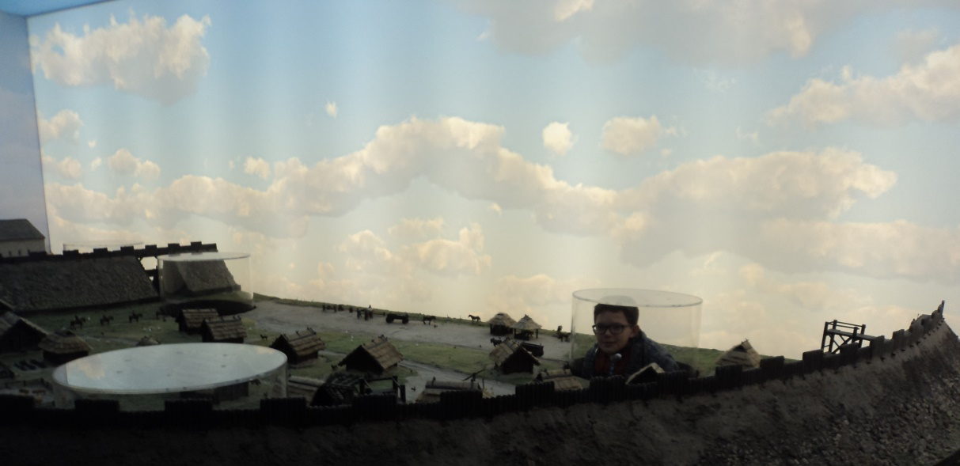
Heritage
smell
Poznan
Museum

Slide 14
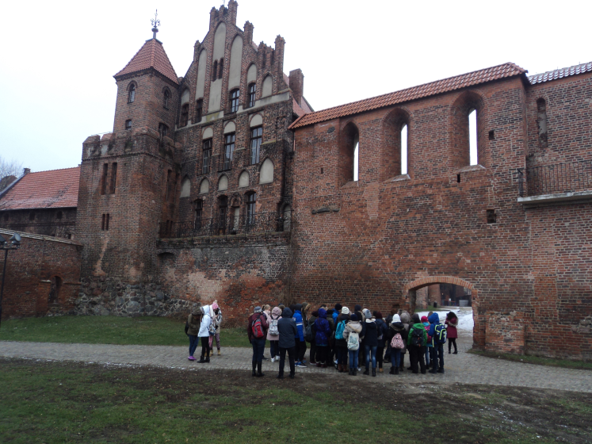
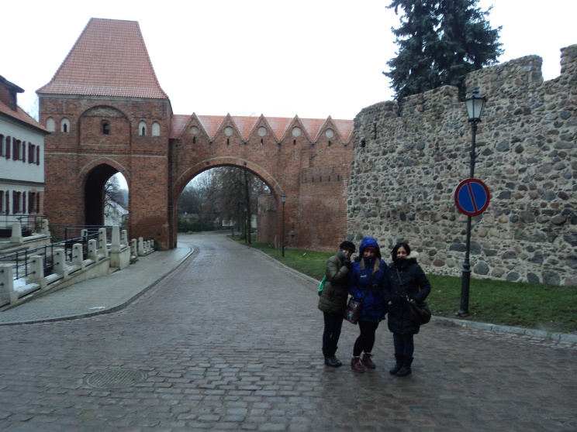
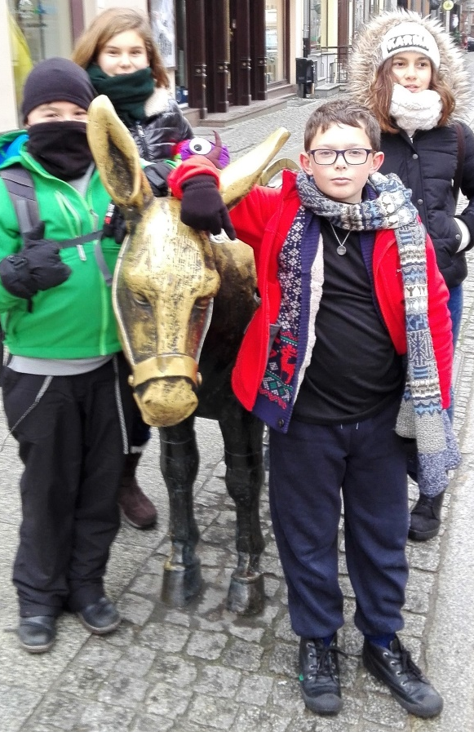
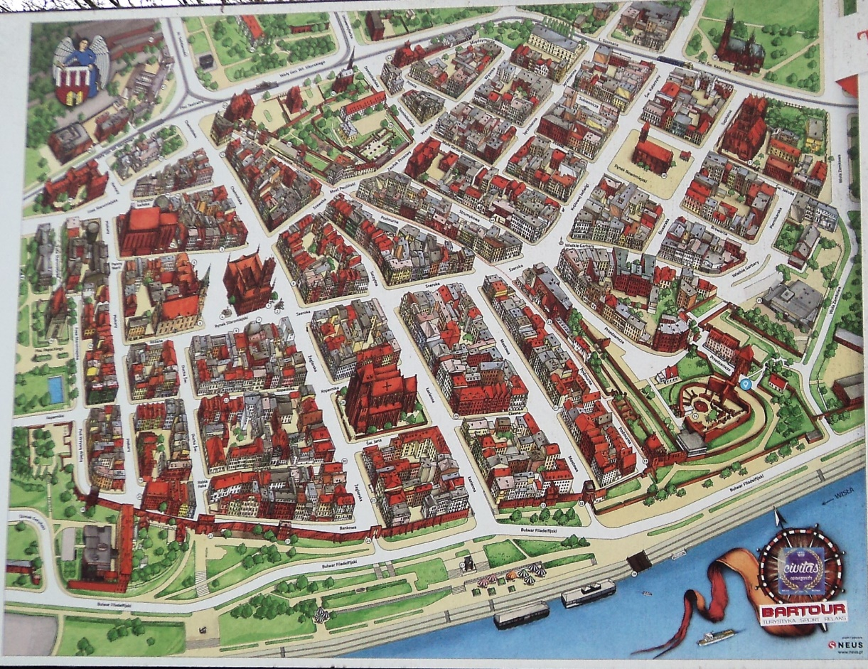
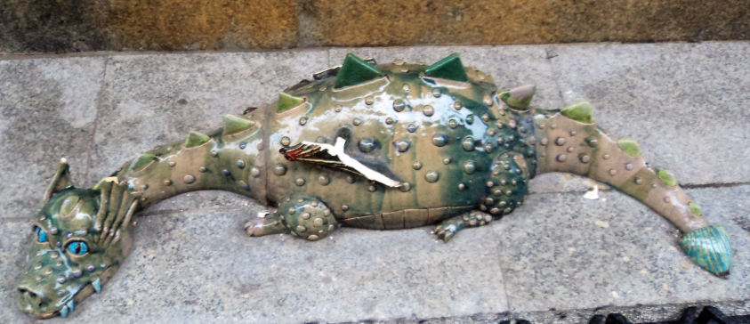
History
smell
Torum
city

Slide 15
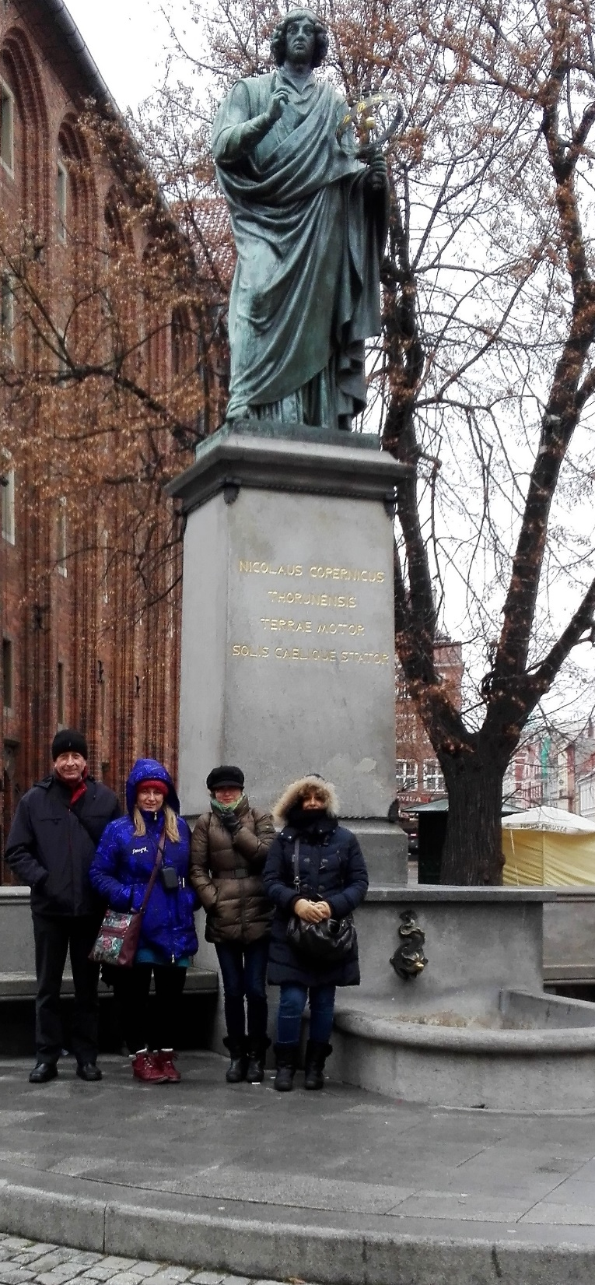
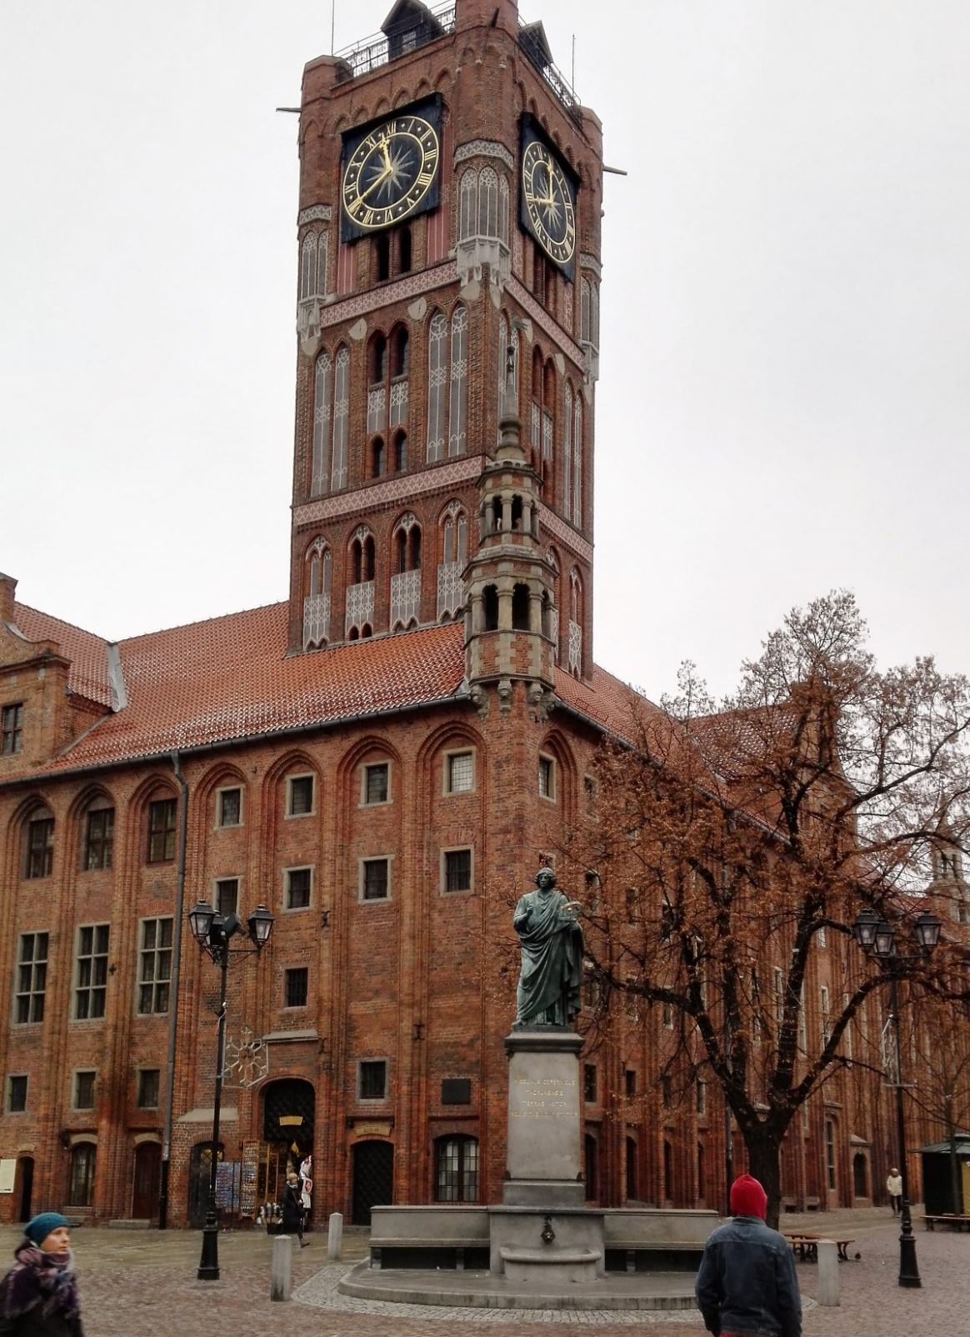
History
smell

Slide 16
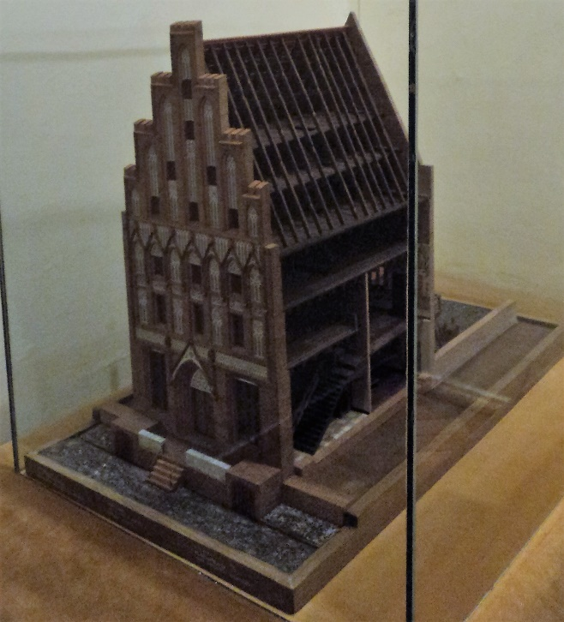
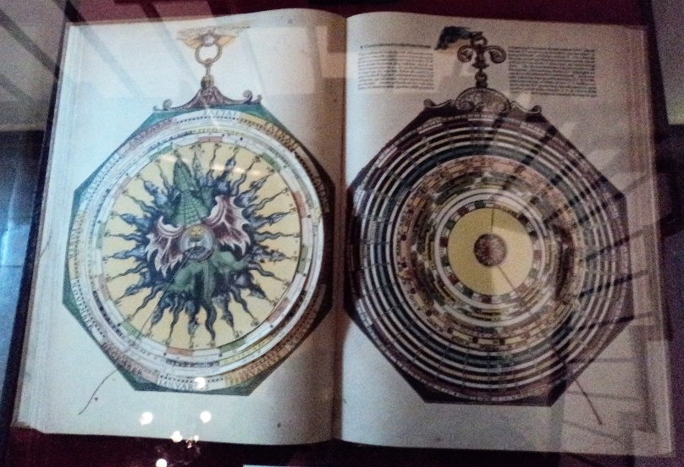
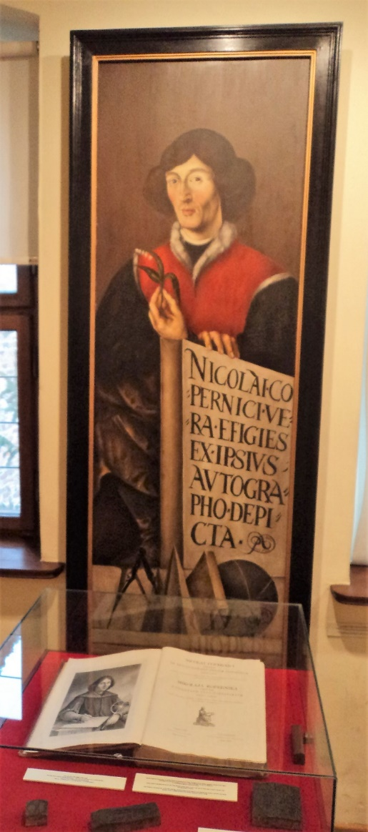
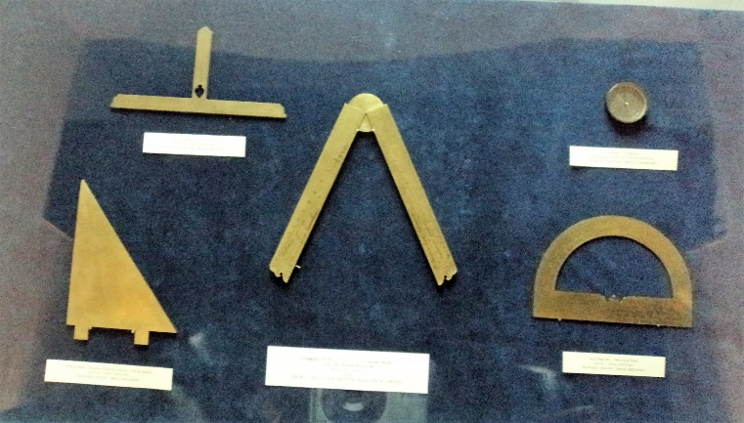
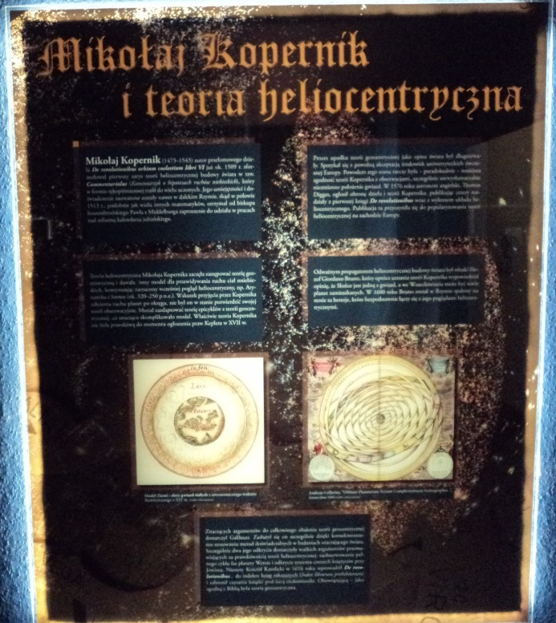
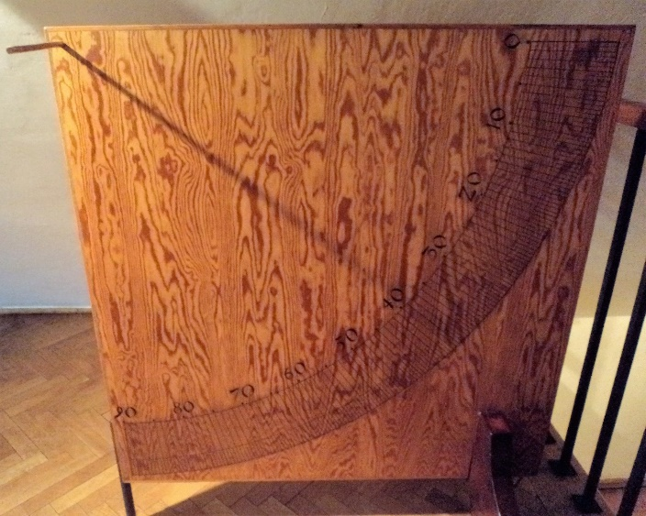
History
smell

Slide 17
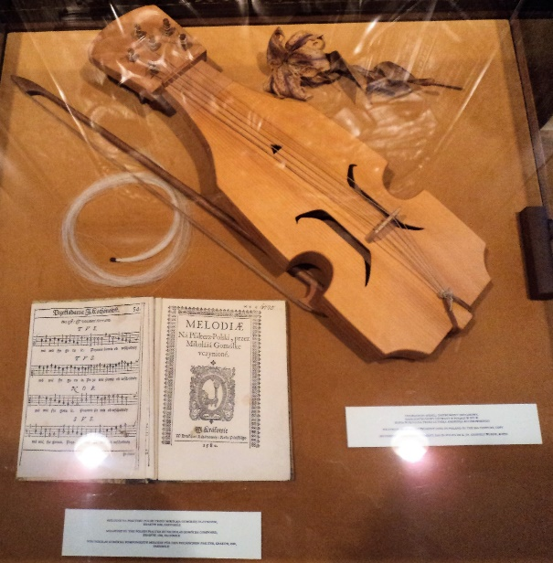
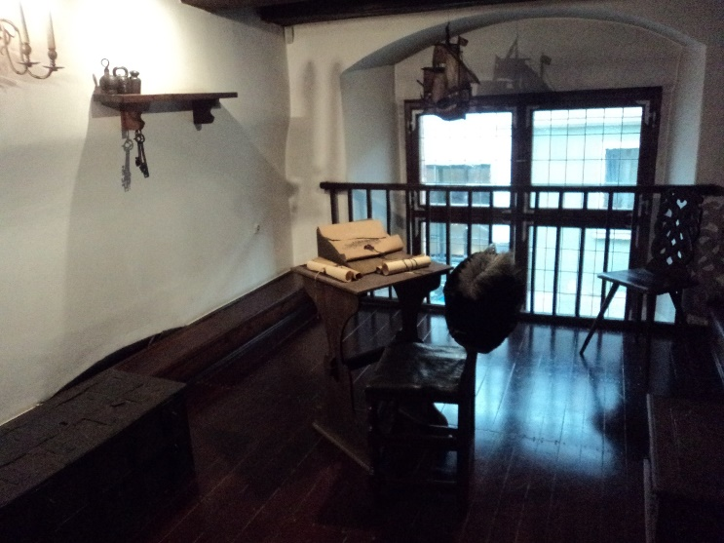
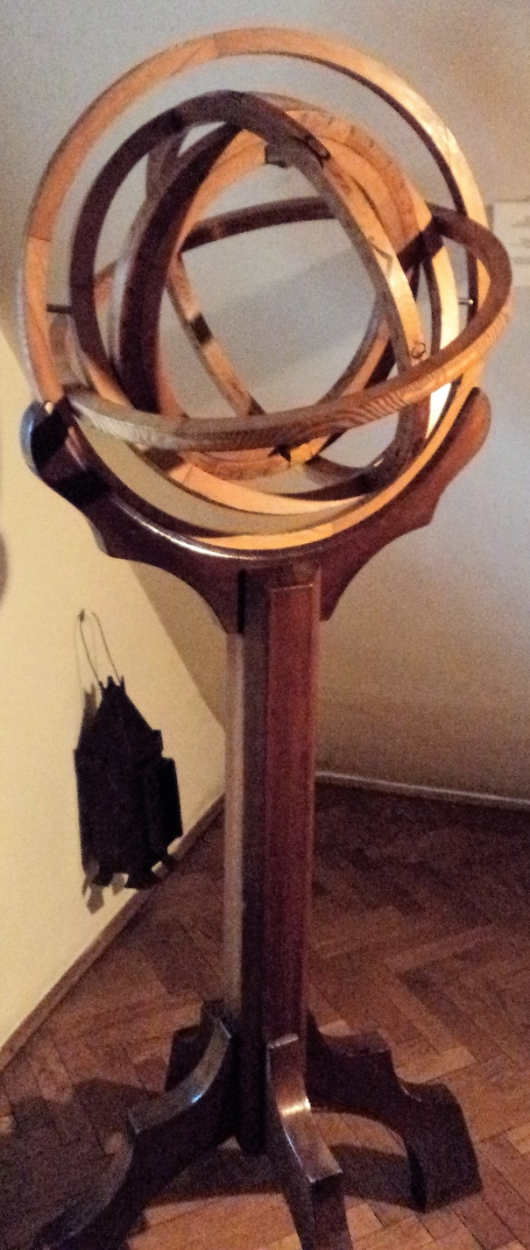
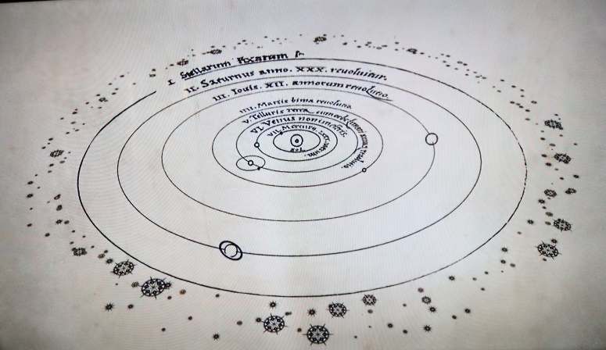
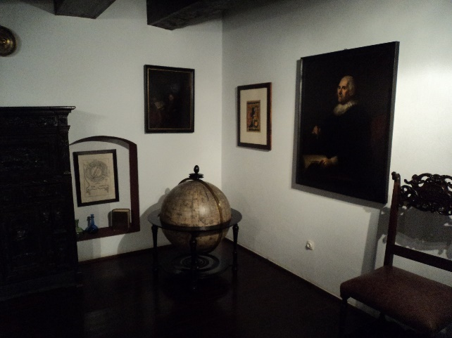
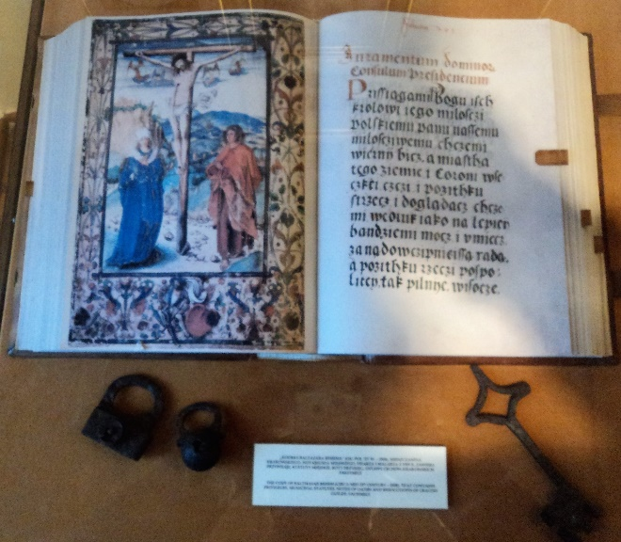
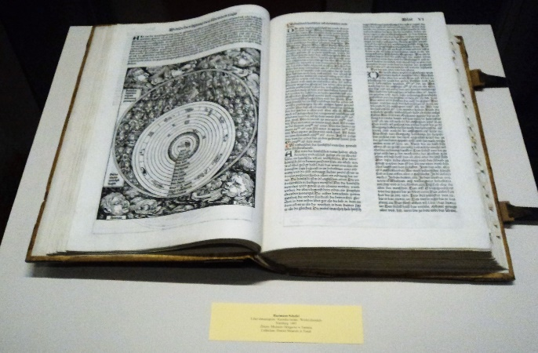

Slide 18
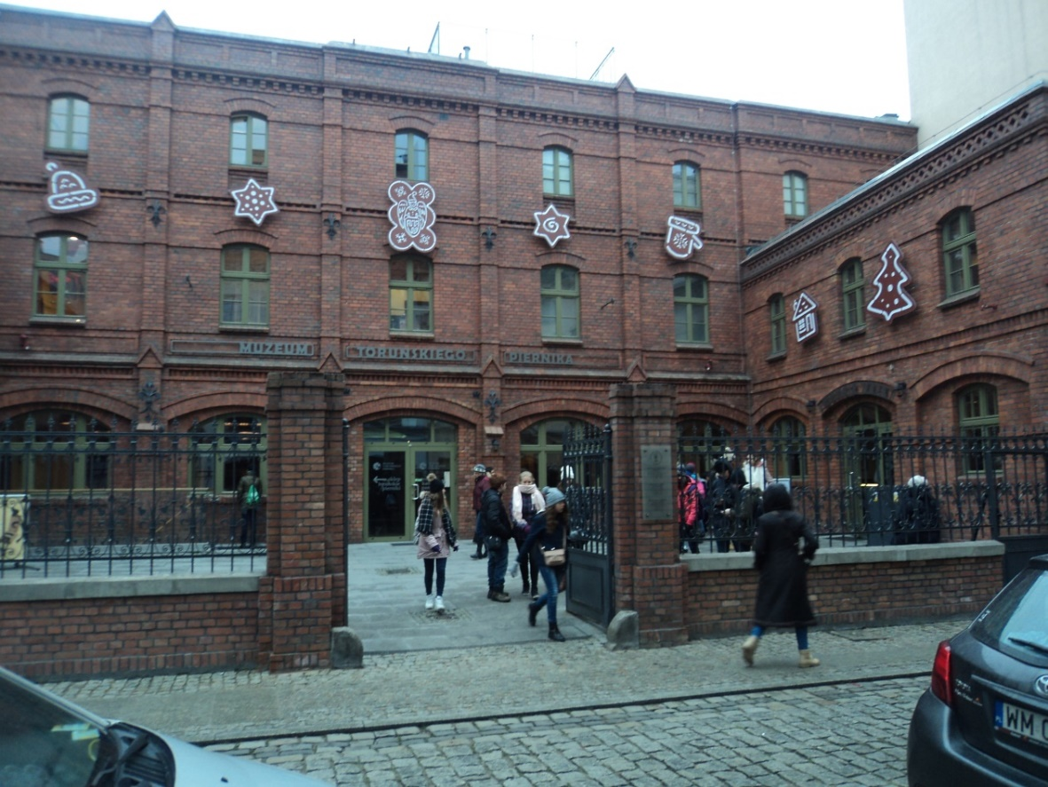
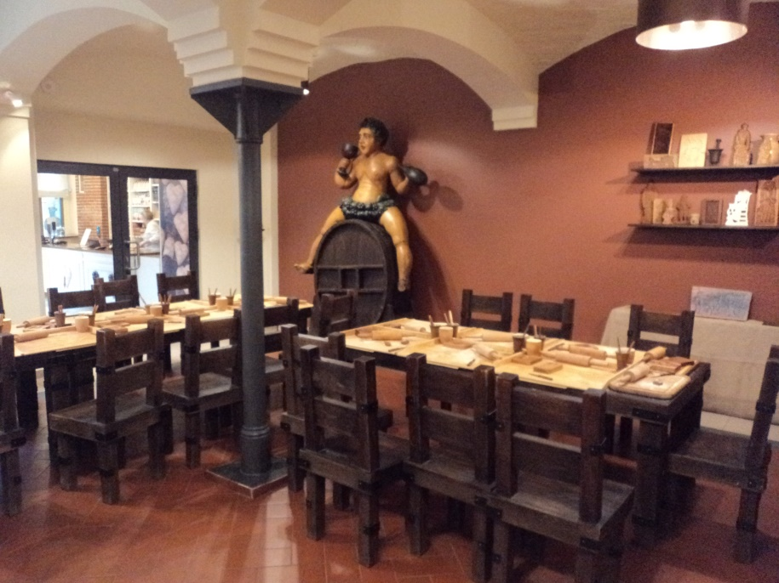
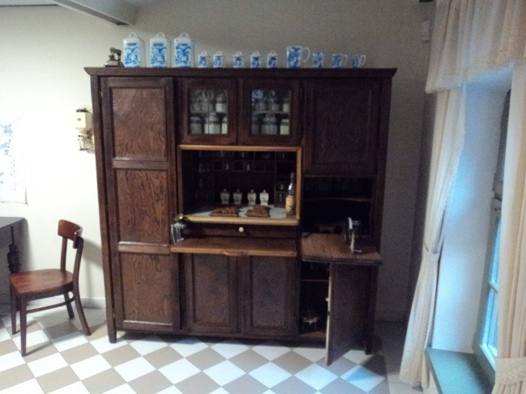
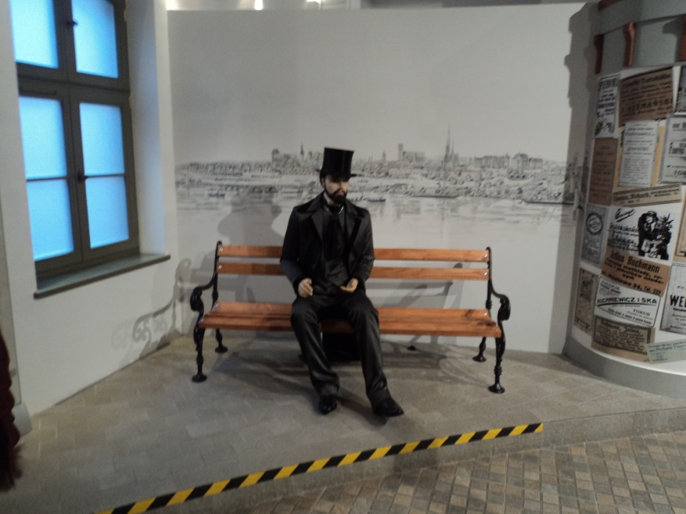

Tradition
smell

Slide 19




Traditions smell

Slide 20

The smell makes more powerful: the fraternity, friendship, complicity

Slide 21




welcome smell

Slide 22



welcome smell

Slide 23
In fact,
In the second acepcion of the definition from the Real Spanish Academy
smell it defines as
“Sagacity to discover or understand what is hide or covert”.

Slide 24




We discover
¡¡ The surprise !!

Slide 25





We understand the priority of Education.

Slide 26





Teaching
Smell

Slide 27



Teaching
Smell

Slide 28





Succesful
smell

Slide 29



Succesful
smell

Slide 30





Universal culture smell

Slide 31



Universal culture smell

Slide 32











The smell
of fraternity

Slide 33







THE SMELL OF ERASMUS GASTRONOMY

Slide 34




The smell of traditional food

Slide 35






Slide 36






Slide 37


The smell of goodbye
Mixed emotions
Last looks

Slide 38




The smell of goodbye

Slide 39

POLAND
ETHROUGH
OUR SENSES

Slide 40

Presentation made by

Slide 41


